Slide 1
At first I have checked which features might be useful for predicting if user will subscribe to the term deposit after calling him. In order to do that I have calculated chi square for categorical features and correlation for continuous features and I have made bar plots and violin plots. Results can be found in the jupyter notebook.
It looks like all the columns might be helpful for making predictions except for ‘month’, day_of_week’, ‘cons.price.idx’, ‘cons.conf.idx’ and ‘euribor3m’. Although I am not sure about the ‘marital’ and ‘contact’ ones, they might not be relevant as well. I am not using the ‘emp.var.rate’ column because I am using ‘nr.employed’ instead and it looks like those columns means pretty much the same.
For making predictions we don’t take into consideration the ‘duration’ column because we don’t know a duration before we call someone.
What is worth to notice is that graphs show that in some months we have higher rate of clients who subscribed to the term deposit but that is probably caused by the fact that in those months there was higher number of employees.

Slide 2
In our dataset we have a mix of both categorical and continuous variables and in order to deal with that I have choosen to build a model which at first takes as input categorical variables encoded using one hot encoding and this input is feed to a neural network. Output of that neural network is then concatenated with the continuous variables and this is an input for another neural network. Architecture of that model is shown on a below picture.
categorical data
neural network
middle output
continuous data
neural network
final output

Slide 3
Another problem was that our dataset was imbalanced. Variable ‘y’ indicates if a client subscribed to the term deposit and there was a lot of samples where y = ‘no’ and small amount of samples where y = ‘yes’. In order to deal with this I have choosen to create a few smaller datasets where each dataset contains all the samples where y = ‘yes’ and the same amount of samples where y = ‘no’. It is ilustrated below. I have trained seperate models for each smaller dataset. After that in order to make predictions I was taking an average from each model’s output.
dataset 1:
sample 1: y = ‘no’
sample 2: y = ‘no’
sample 5: y = ‘yes’
Original dataset:
sample 1: y = ‘no’
sample 2: y = ‘no’
sample 3: y = ‘no’
sample 4: y = ‘no’
sample 5: y = ‘yes’
model 1
dataset 2:
sample 3: y = ‘no’
sample 4: y = ‘no’
sample 5: y = ‘yes’
model 2

Slide 4
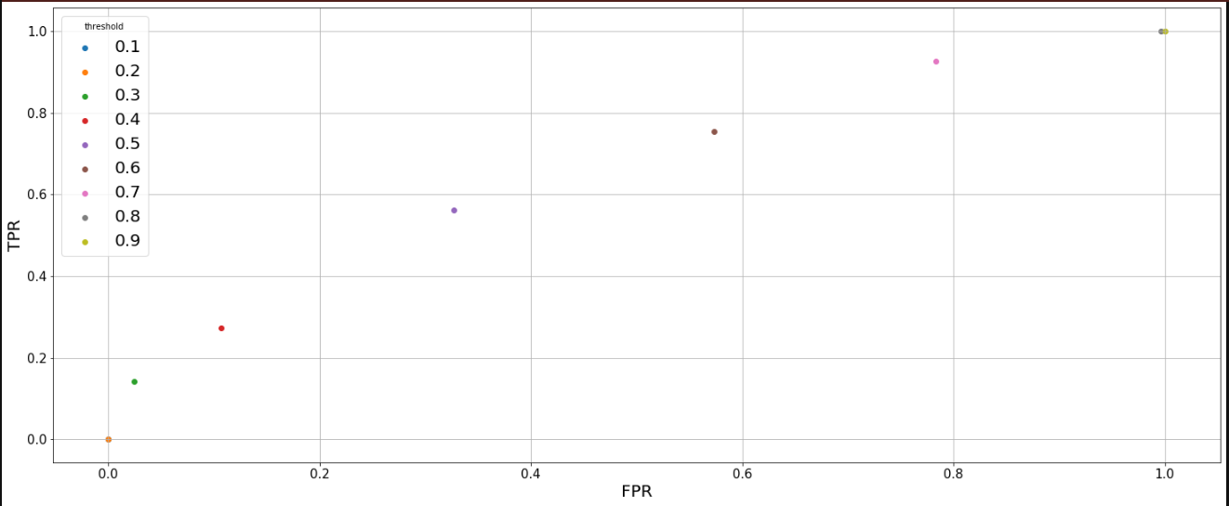
Here is a ROC graph for my model. It looks like a decision threshold = 0.5 should be the best. AUC value for that model equals = 0.658

Slide 5
There is also another way to choose the best threshold. We will be using this model in such a way that we take all the data about clients, predict if they will subscribe and we will call to all those clients for who model predicted that they will subscribe.
Now the question is how many of them will the most probably actually subscribe? We have a fixed budget, let’s say that we want to call about 18000 clients as previously, so we want our model to find around 18000 clients that will subscribe and we want to have as high precision as possible.
How many positives our model will predict (how many clients will subscribe) and precision depends on what threshold we will choose. I have noticed that lower threshold causes that the model has a higher precision but it less often predicts positives.
So if for example we will see that for our dataset model predicts 30 000 positives we can lower a threshold because we won’t call all 30 000 clients, we will call just 18 000 of them and with a lower threshold we will have a higher precision.

Slide 6
So what I did is:
At first I have calculated a precision for different thresholds using dataset with clients from a campaign group.
Then I have used my model to make predictions using different thresholds for a whole dataset with all clients from both campaign and control group.
I have checked number of predicted positives (client will subscribe) for a whole dataset and I calculated estimated number of true positives using precision which I calculated previously (estimated number of true positives = precision * number of predicted positives). For example if I see that the model predicted 10 000 positives for a whole dataset and I know that precision = 25% then estimated number of true positives will be 2500.

Slide 7
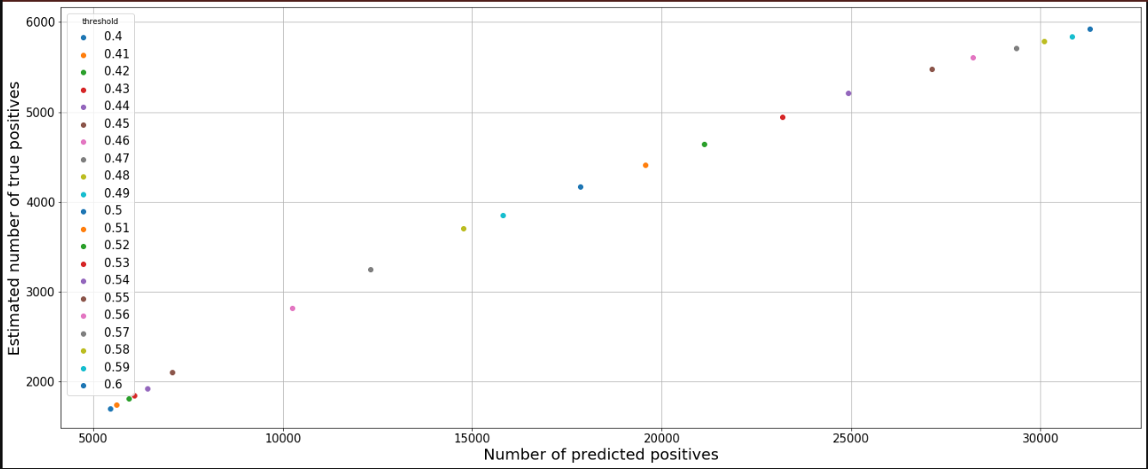
This graph shows that for a threshold = 0.5 our model predicts around 18000 positives for our dataset (whole dataset with clients from both campaign and control group) and there will be most probably around 4000 true positives. So this also shows that we should choose a threshold equal to 0.5 and this will cause that we will pursuade 1500 more clients to subscribe then in the previous campaign with the same budget.

